Slide 1

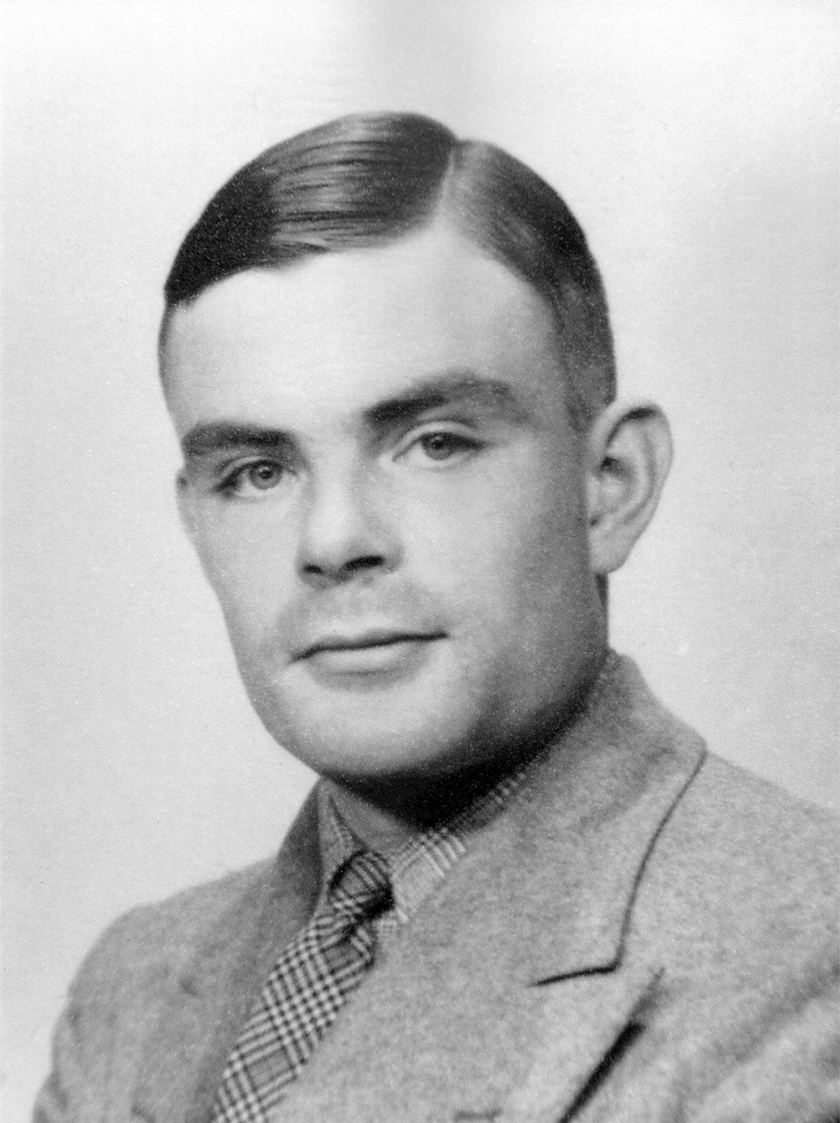
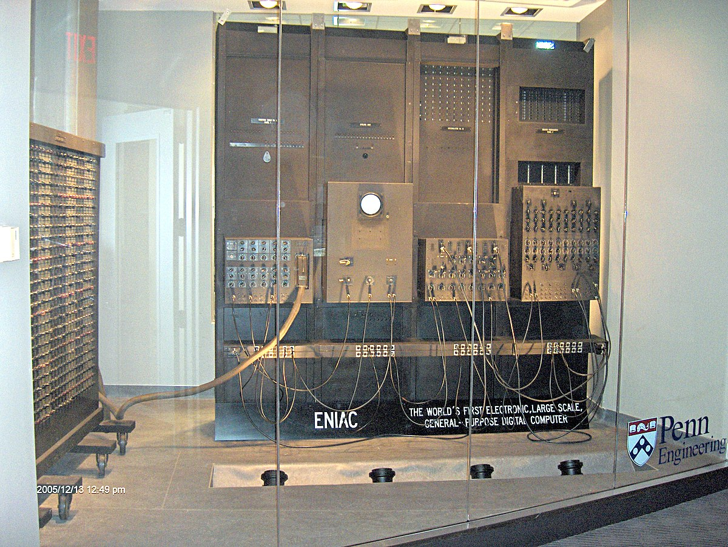
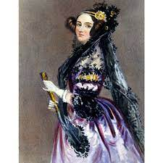
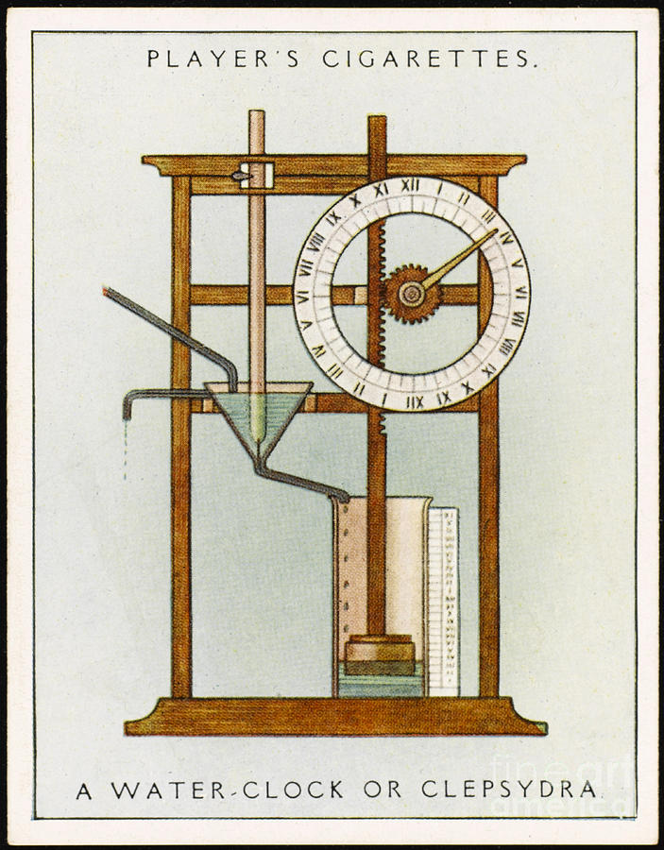
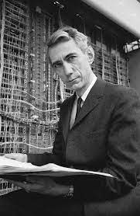
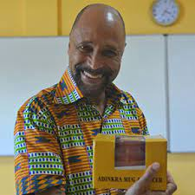
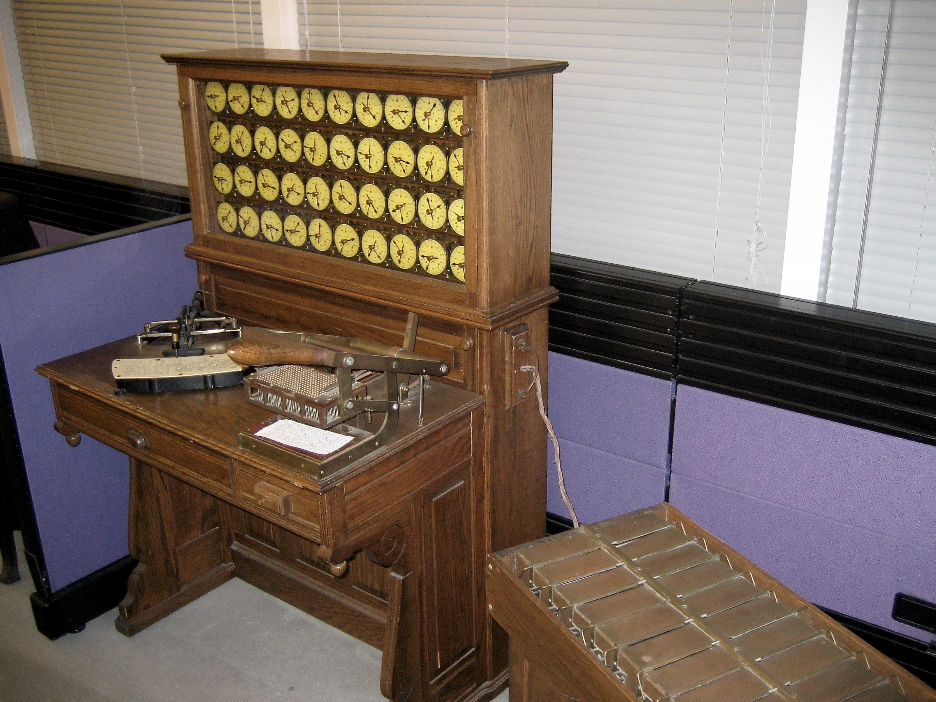
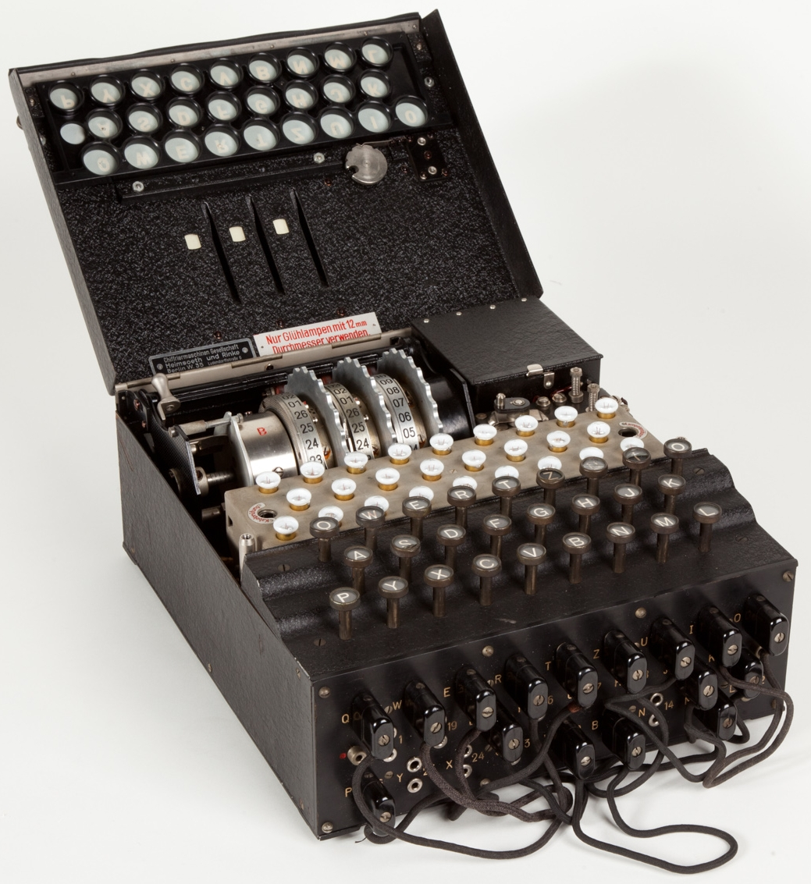
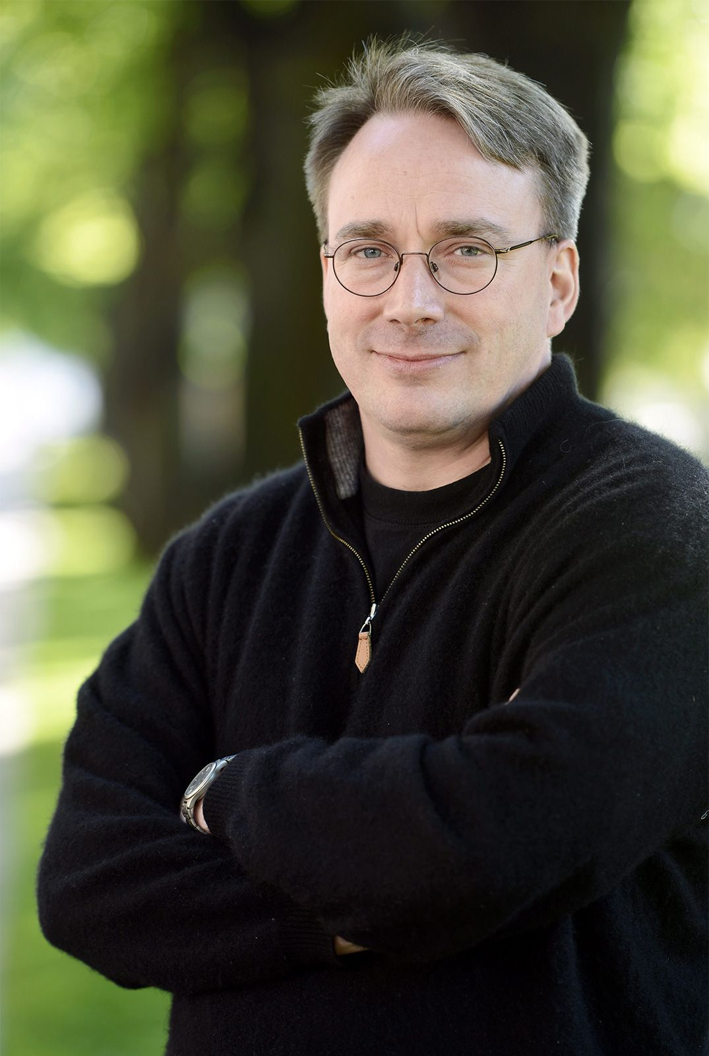
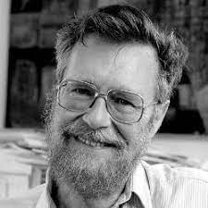
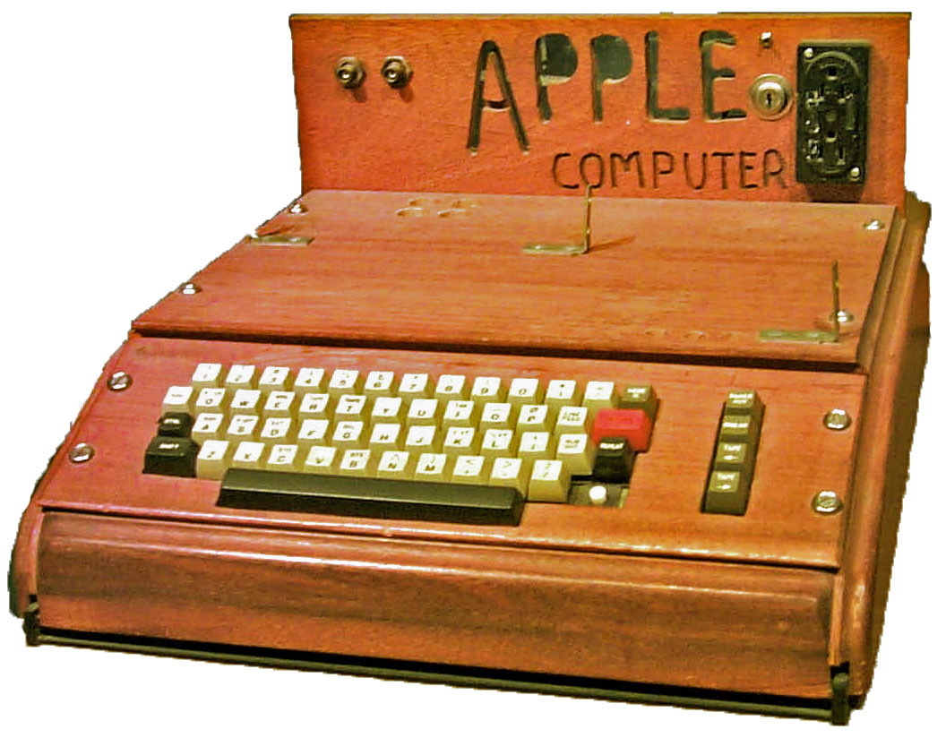
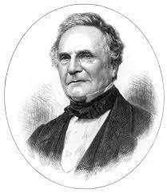
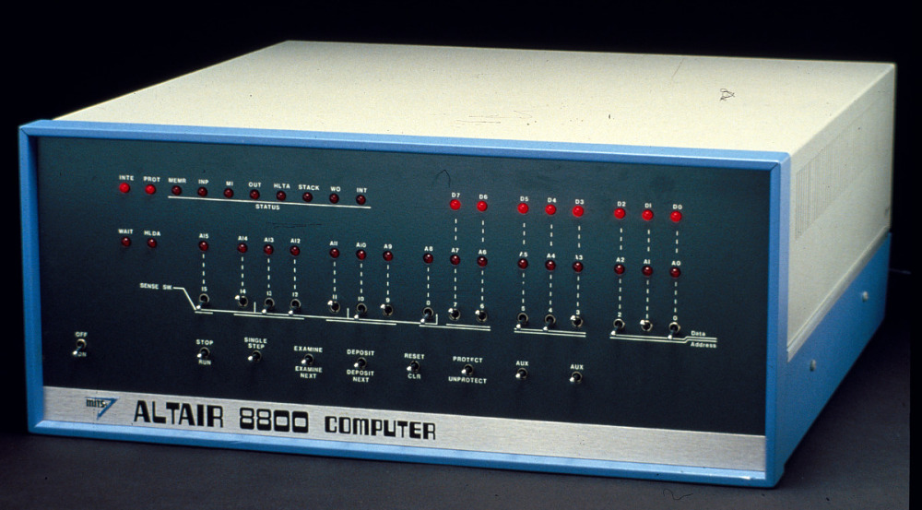
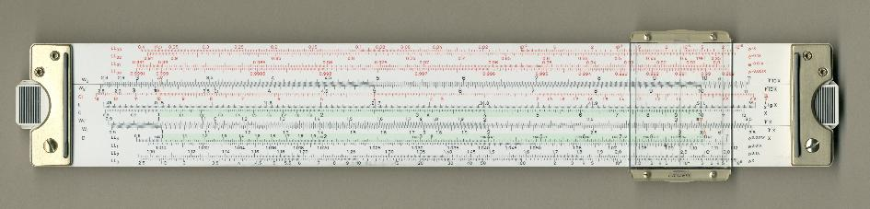
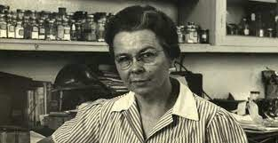
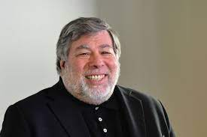
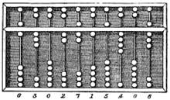
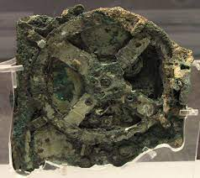
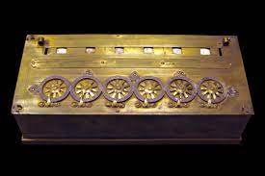
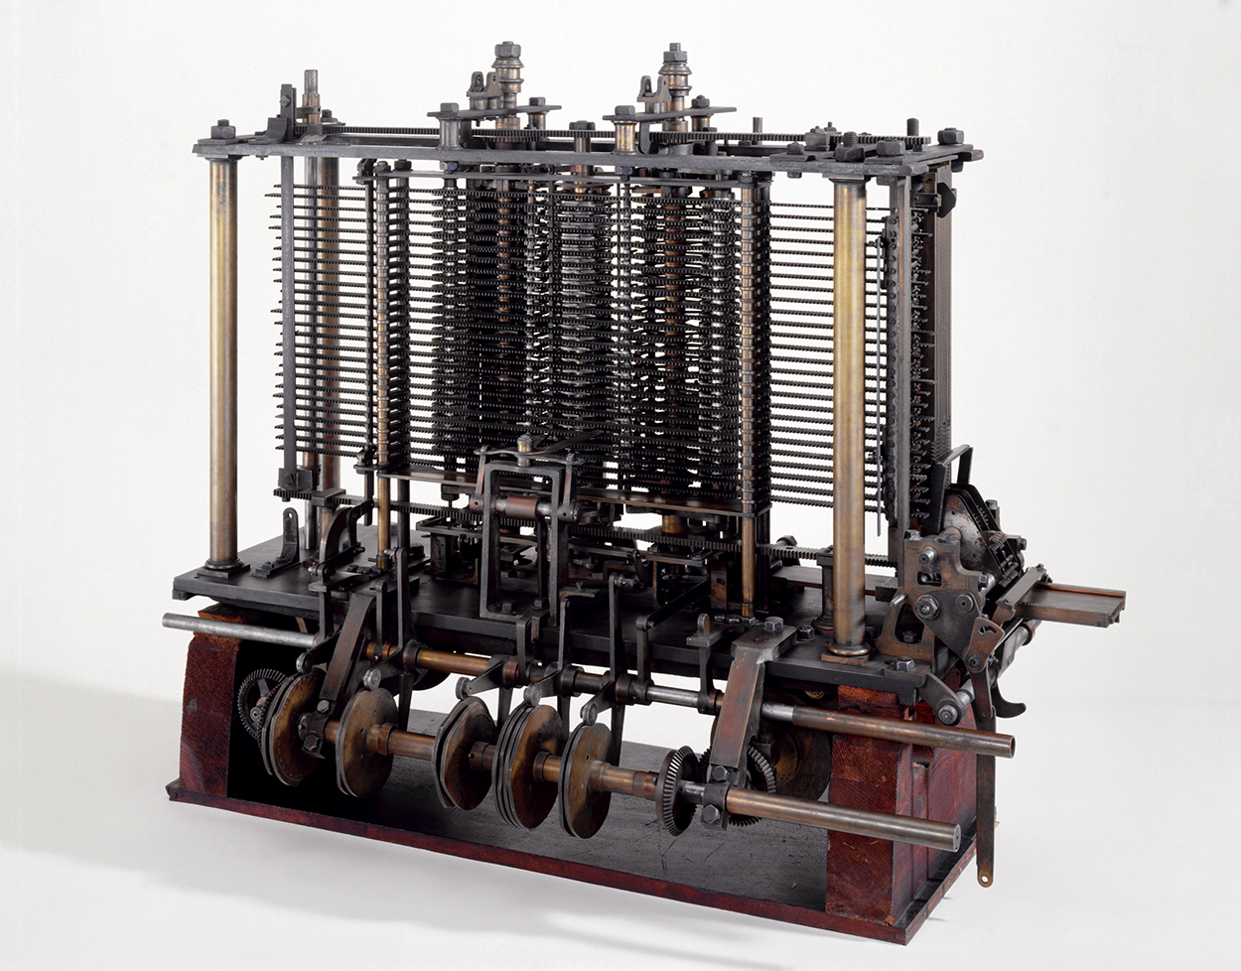
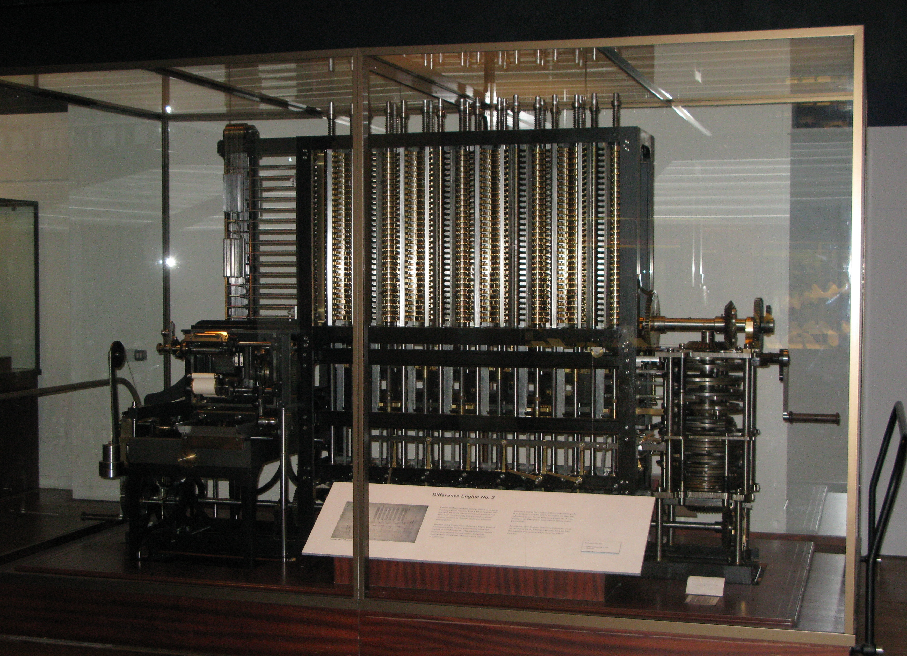
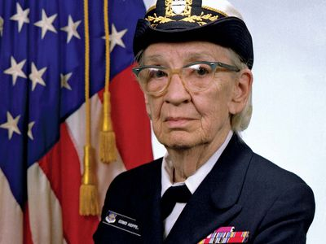
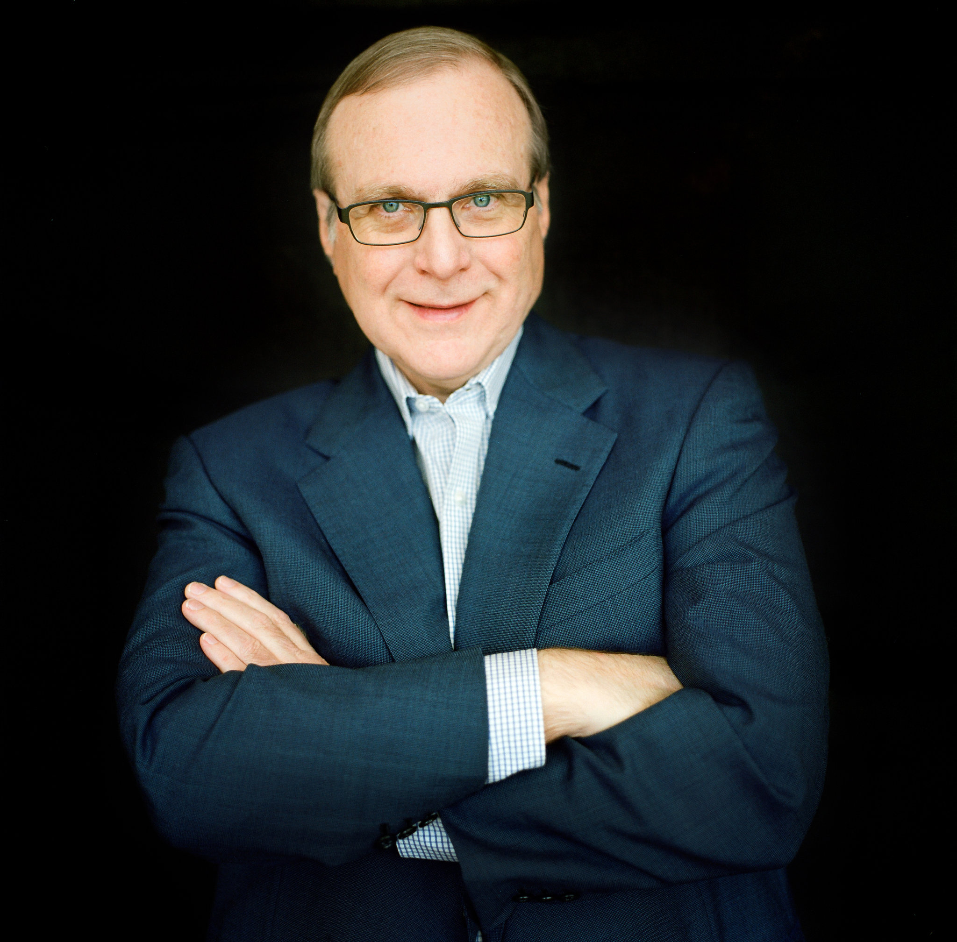
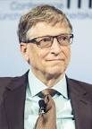
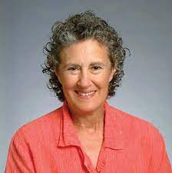
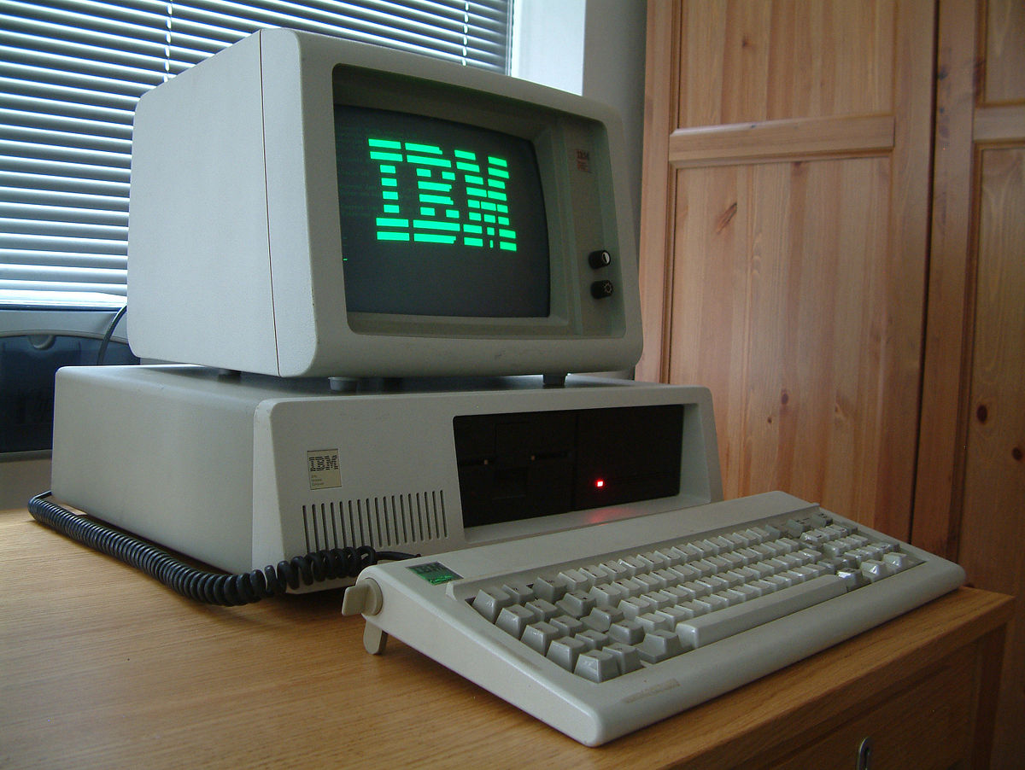
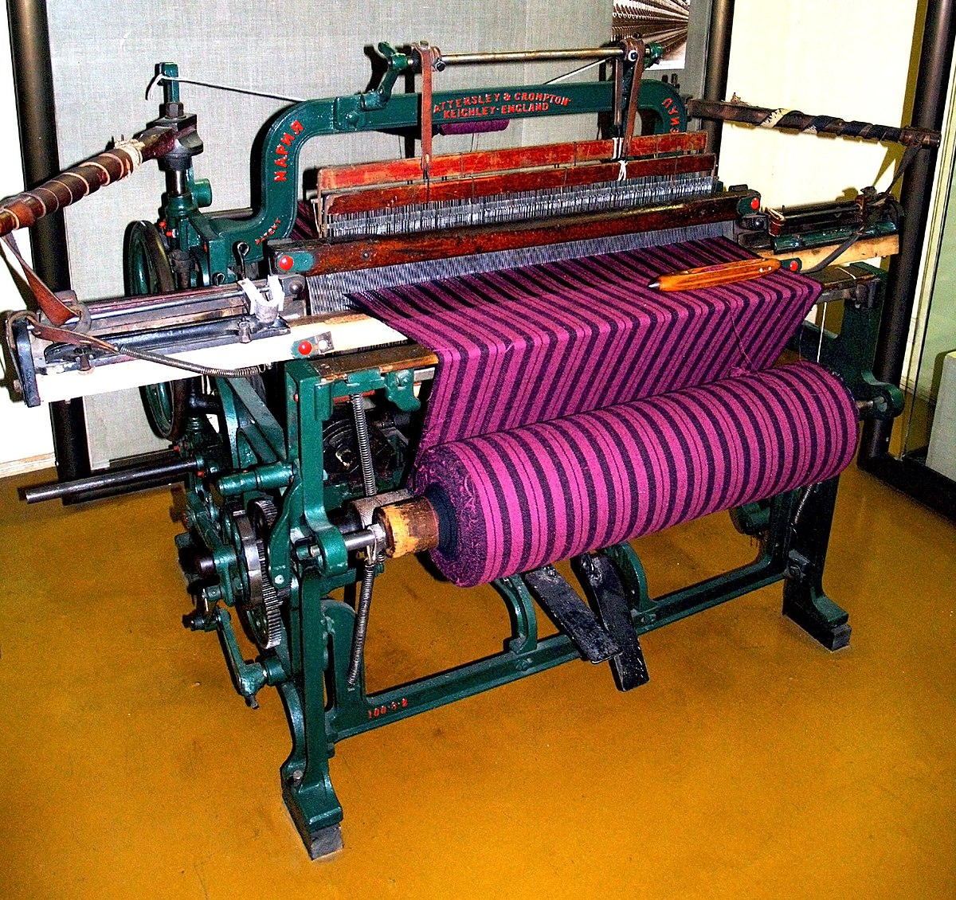
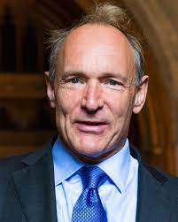
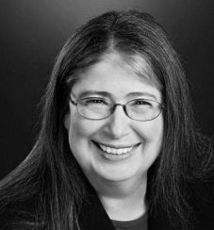
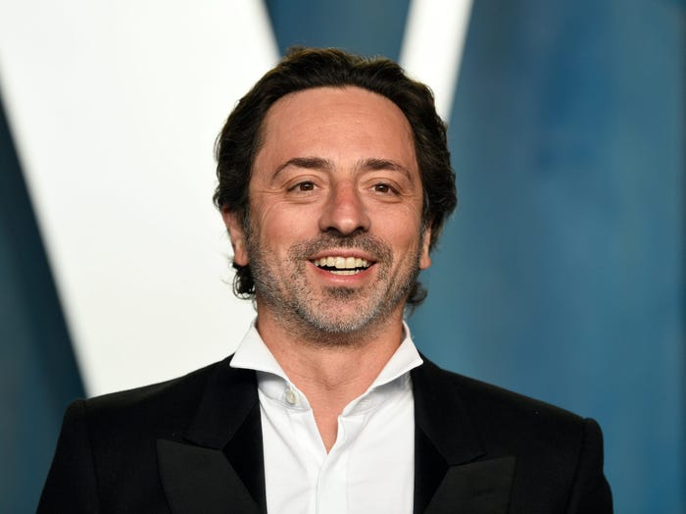
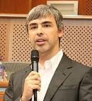
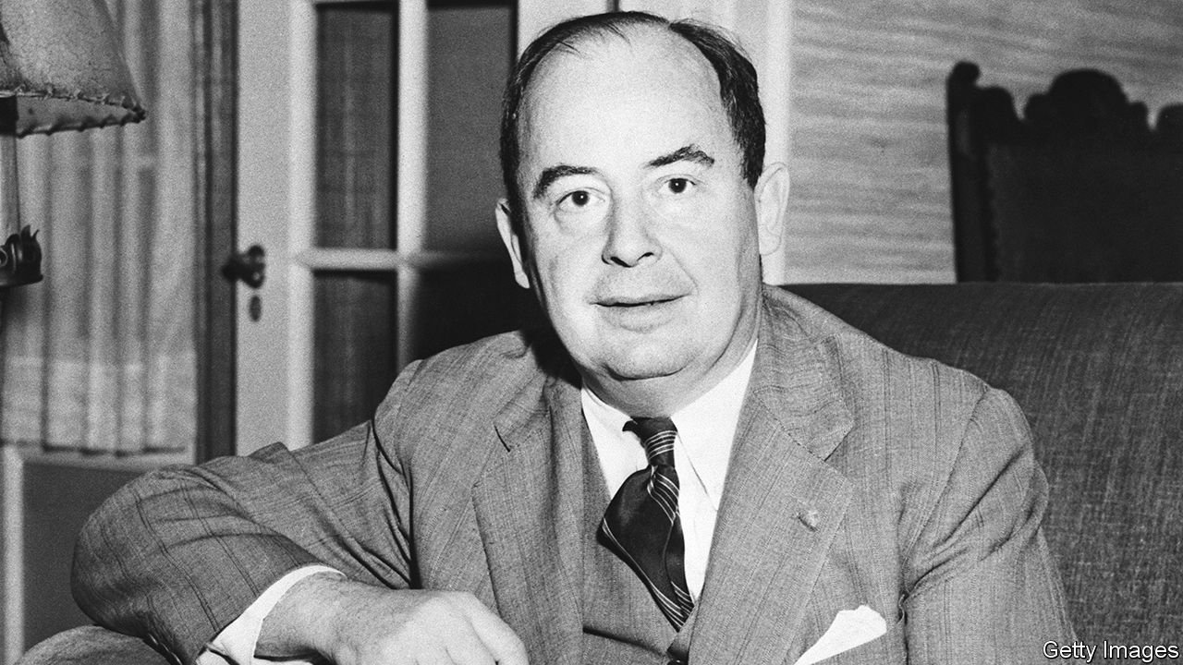
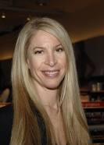
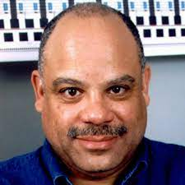
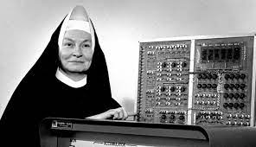
https://en.wikipedia.org/wiki/ENIAC
Alan Turing (1912-1954)- He’s considered a founder of computer science.
https://www.britannica.com/biography/Alan-Turing
ENIAC Developed
Created by: Programmed by Six Women
Time: 1942-1945
Facts: It was 27 tons and the size of a room.
www.alamy.com
Ada Lovelace (1815-1852)- Helped with the Analytical Engine.
https://www.computerhistory.org/babbage/adalovelace/
https://en.wikipedia.org/wiki/Tabulating_machine
https://en.wikipedia.org/wiki/Enigma_machine
Claude Shannon (1916-2001)- He wrote “A Mathematical Theory of Communications”
https://www.newyorker.com/tech/annals-of-technology/claude-shannon-the-father-of-the-information-age-turns-1100100
Clarence Ellis (1943-2014)- First African American to earn a Ph D in computer science.
https://cs.illinois.edu/about/awards/alumni-awards/alumni-awards-past-recipients/clarence-ellis
www.math.utah.edu
Edsger Dijkstra (1930-2002)- helped with compiler construction, operating systems, concurrent programming, and distribute programming
https://cacm.acm.org/magazines/2010/8/96632-an-interview-with-edsger-w-dijkstra/fulltext?mobile=false .
The Altair
Created by: Ed Roberts
Time: 1974.
Facts: The first widely accessible machine.
https://americanhistory.si.edu/collections/search/object/nmah_334396
Water Clocks
Created by: Al Jazari
Time: 325 BC
Facts: It was a weight driven device that was the earliest version of an alarm clock.
Slide Rule
Created by: William Oughtred.
Time: 1620s.
Facts: A manual device used for simple calculations.
Edith Clarke (1883-1959)- Invented the Calculator.
http://www.zoefact.com/arts/biography/biography-of-edith-clarke.html
Hollerith Tabulating machine
Created by: Herman Hollerith.
Time: 1887.
Facts: Was developed to help process data.
Enigma Machine
Created by: Arthur Scherbius
Time: 1918.
Facts: used for communication.
Linus Torvalds(1969-Present)- Developed the Linux Operating System.
https://www.britannica.com/biography/Linus-Torvalds
Apple 1
Created by: Steve Wozniak (and/or Steve Jobs)
Time: 1975
Fact: The first modern computer, that started the Apple Franchise we know now
Charles Babbage (1791-1871)- Developed Difference and Analytical Engines.
https://www.britannica.com/biography/Charles-Babbage
Steve Wozniak (1950-Present) / Steve Jobs (1955-2011)- Created the Apple II machine.
https://www.britannica.com/biography/Stephen-Gary-Wozniak
2800 B.C 325 B.C. 150 B.C. 1620s 1640s 1800s 1870s 1880s 1900s 2000s
Abacus
Created by: Mesopotamia and Sumerian civilizations.
Time: 2700 BC.
Facts: Also known as a counting frame.
Antikythera
Created by: ?
Time: 150-100 BC
Facts: It was an analogue calculator that could predict star positions and other astronomical phenomenon.
Pascaline
Created by: Blaise Pascal
Time: 1642
Facts: Early version of a calculator could only do addition.
The Loom
Created by: Jacquard Loom
Time: 1801
Facts: It operated using a punch card system in which you'd feed a punch card to the analogue machine in order tow get a result.
Analytical Engine
Created by: Charles Babbage
Time: 1870's
Facts: It had a logic unit, control flow, conditional branching and loops.
Difference Engine
Created by: Charles Babbage
Time: 19th Century
Facts: It was a machine that could tabulate polynomial functions.
Grace Hopper(1906-1992)- Worked on Harvard Mark I also invented the first compiler.
https://www.britannica.com/biography/Grace-Hopper
Paul Allen(1953-2018) and Bill Gates(1955-Present)- Started MicroSoft together.
https://www.nytimes.com/2018/10/15/obituaries/paul-allen-dead.html
https://en.wikipedia.org/wiki/Bill_Gates
Tim Berners-Lee (1955-Present)- Credited with inventing the World Wide Wed.
https://en.wikipedia.org/wiki/Tim_Berners-Lee
Barbara Liskov (1939- Present)- She won the Turing Award for sormulating the Liskov Substitution Principle.
https://www.britannica.com/biography/Barbara-Liskov
Radia Perlman (1951-Present)- Developed the Spanning Tree Algorithm.
https://internethalloffame.org/inductees/radia-perlman
Sergey Brin(1973-Present) and Larry Page(1973- Present)- Developed the foundation of the Google search engine.
https://www.businessinsider.com/sergey-brin-google-alphabet-life-photos-2016-12
https://en.wikipedia.org/wiki/Larry_Page
www.wikepedia.org
https://en.wikipedia.org/wiki/Difference_engine
Carol Shaw (1955-Present)- Worked for Atari and Activision and wrote “River Raid.”
http://t3.gstatic.com/licensed-image?q=tbn:ANd9GcT945kFVpCe0Kp_gcORbOoKtt267ngkEVN5xvtlc71FFLVx6jhANEeaq6kC3VOyoSQo
Mark Dean(1957-Present)- Was a key member of the team that created the ISA bus for IBM.
https://www.biography.com/inventor/mark-dean
IBM PC
Created by: Mark Dean
Time: 1981.
Facts: The first Microcomputer.
https://en.wikipedia.org/wiki/IBM_5151
www.wikepedia.org
https://www.britannica.com/technology/Analytical-Engine
John Von Neumann (1903-1857)- Worked on the Manhattan project
https://www.economist.com/books-and-arts/a-new-biography-explains-the-genius-of-john-von-neumann/21805346
Mary Kenneth Keller (1913-1985)- Was the first woman to get a Ph D in computer science.
https://www.cs.wisc.edu/2019/03/18/2759/
www.wikepedia.org
www.wikepedia.org
Team Members:
Chase Hall, Sam Kauffman, Tyler Lericos

